Slide 1

DIGITAL LOGIC DESIGN
by
Dr. Fenghui Yao
Tennessee State University
Department of Computer Science
Nashville, TN
Notes:
^*#{}#*^
SHOW merlin, merlin.acs, 83, 80
PLAY Confused
PLAY RestPose
PLAY Explain
SAY Welcome to the second lecture of the CS 311.
SAY Dr. Ali Sekmen will be teaching this class for this semester.
SAY He will have power point presentations for each lecture. Please feel free to ask any questions you have during the lectures.
2) SHOW genie, genie.acs, 10, 30
2) PLAY Greet
2) PLAY RestPose
2) SAY The details of the course are described in the handouts which were distributed at the beginning of the lecture.
SAY This course will provide you with a deep understanding of Java programming language.
SAY You will be developing both Java Applications and Java Applets.
3) SHOW peedy, peedy.acs, 10, 70
3) PLAY Greet
3) PLAY RestPose
3)SAY You will also develop some practical applications in graphics, multimedia, database connectivity, networking, and Internet.
4)SHOW robby, robby.acs, 80, 30
4)PLAY Greet
4) PLAY RestPose
2)SAY The prerequisite for this course is a grade of C or better in CS 212.
2) SAY Those who do not meet the prerequisite should withdraw this course.
4) SAY Java is much easier than C and C++ yet more powerful for Internet based developments.
3)HIDE
4)HIDE
SLIDE 2=MOVE 17,17

Slide 2
Definitions
Switching network
  One or more inputs
  One or more outputs
    Two Types
      Combinational
        The output depends only on the present values of the inputs
        Logic gates are used
      Sequential
        The output depends on present and past input values

Slide 3
Boolean Algebra
Network
.
.
.
.
.
.
Outputs
Inputs
Boolean Algebra is used to describe the relationship between inputs and outputs
Boolean Algebra is the logic mathematics used for understanding of digital systems

Slide 4
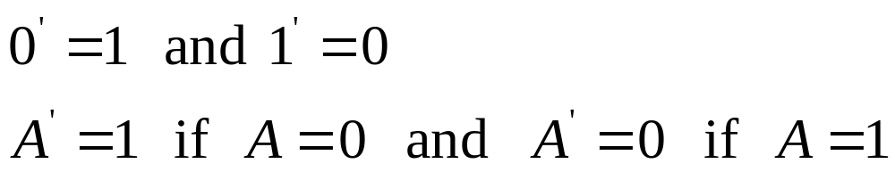
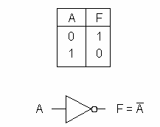
Basic Operations
COMPLEMENT (INVERSE)
0 is low voltage
1 is high voltage

Slide 5
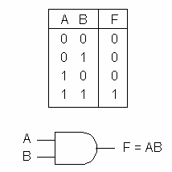
Basic Operations
AND
F is 1 if and only if
A and B are both 1

Slide 6
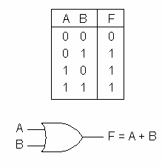
Basic Operations
OR
F is 1 if and only if
A or B (or both) are 1

Slide 7
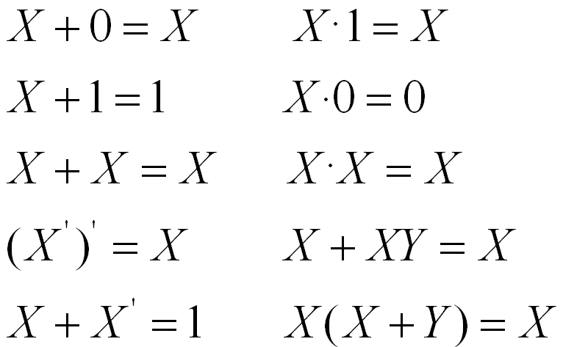
Basic Theorems
Let’s prove each one

Slide 8
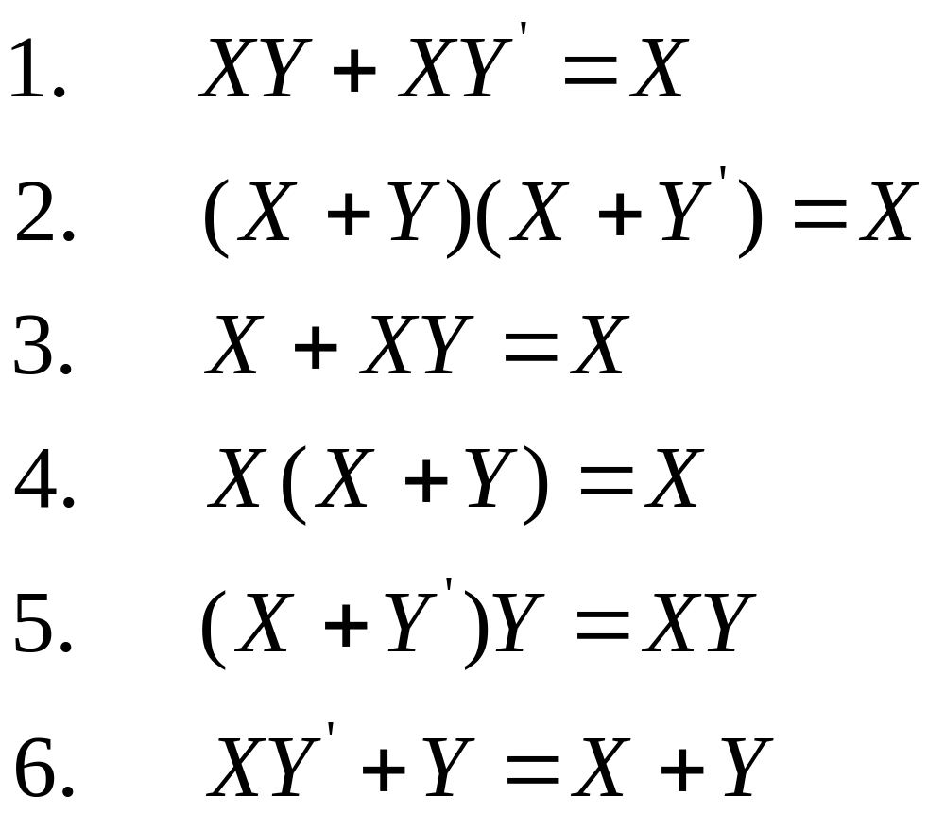
Simplification Theorems

Slide 9
Proof 6.
R.H.S. = X+Y
= X(Y+Y’)+Y(X+X’)
= XY+XY’+XY+X’Y
= XY+XY’+X’Y
= (X+X’)Y+XY’
= Y+XY’
= L.H.S.

Slide 10


Truth Table
It can represent a boolean function
For possible input combinations it shows the output value
There are rows (n is the number of input variables)
It ranges from 0 to

Slide 11
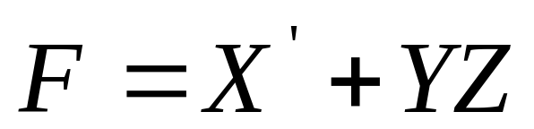
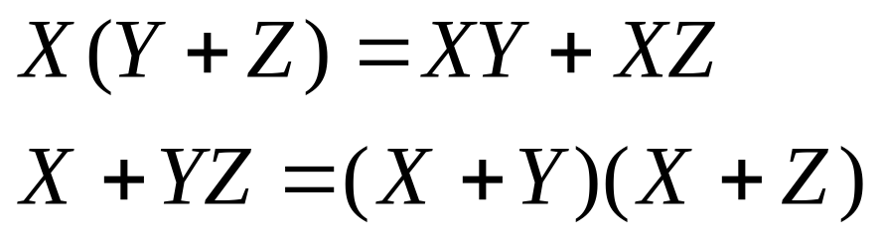
Examples
Show the truth table for
Show the followings by constructing truth tables

Slide 12
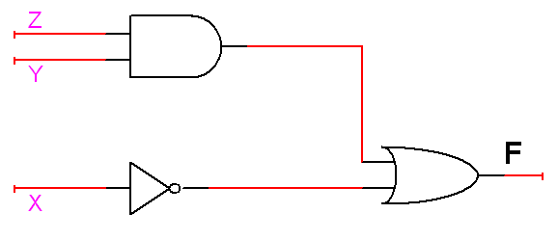
Example
Draw the network diagram for

Slide 13
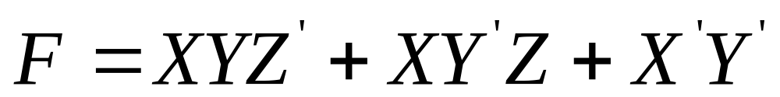
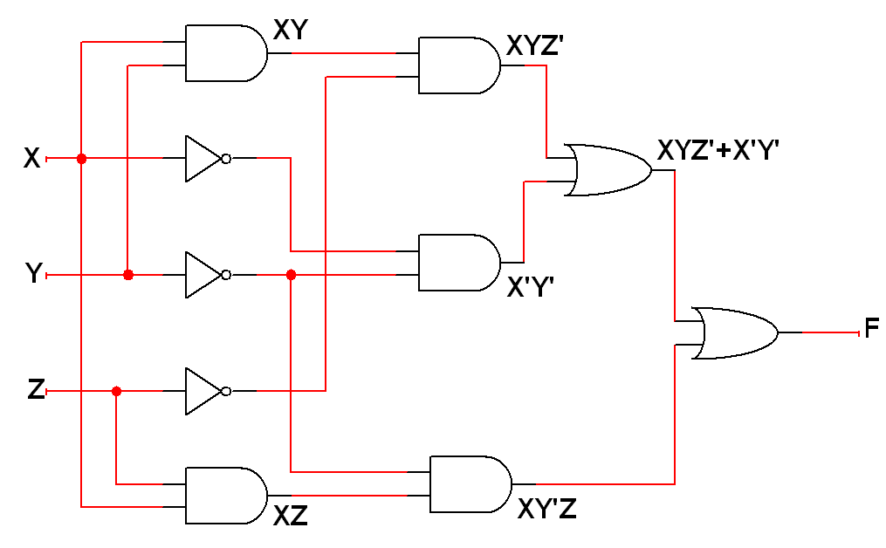
Example
Draw the network diagram for

Slide 14
Operator Precedence
Parenthesis
NOT
AND
OR

Slide 15
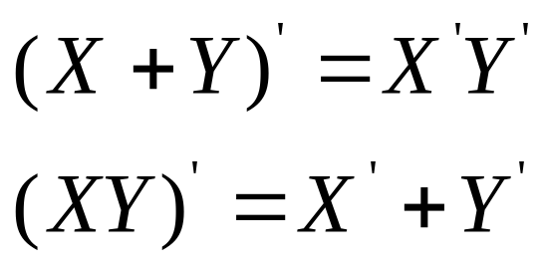
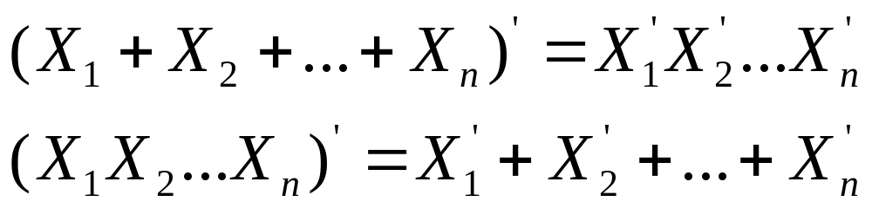
Inversion
Prove with the truth tables…
The complement of the product is the sum of the complements
The complement of the sum is the product of the complements

Slide 16
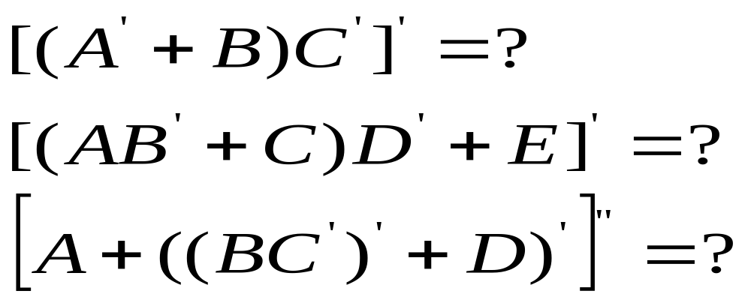
Examples
Find the complements of

Slide 17
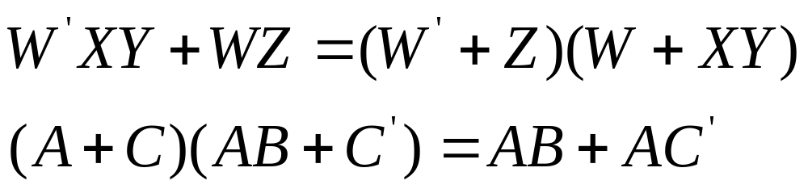
Study Problems
1. Draw a network to realize the following by using only one AND gate and one OR gate
2. Draw a network to realize the following by using two OR gates and two AND gates
3. Prove the following equations using truth table

Slide 18
Solution of problem 2
L.H.S.=(V+X+W)(V+X+Y)(V+Z)
=[(V+X)+W(V+X)+Y(V+X)+WY](V+Z)
=[(V+X)(1+W+Y)+WY](V+Z)
=(V+X+WY)(V+Z)
This can be implemented by two OR gates and two AND gate.

Slide 19
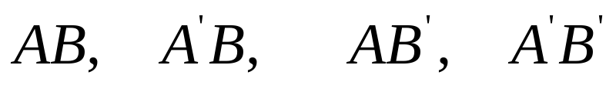
Minterms
Consider variables A and B
Assume that they are somehow combined with AND operator
There are 4 possible combinations
Each of those terms is called a minterm (standard product)
In general, if there are n variables, there are minterms

Slide 20








Exercise
List the minterms for 3 variables
A | B | C | Minterm | Designation
0 | 0 | 0 | A ' B ' C'
0 | 0 | 1 | A ' B ' C
0 | 1 | 0 | A ' B C'
0 | 1 | 1 | A ' B C
1 | 0 | 0 | A B ' C'
1 | 0 | 1 | A B ' C
1 | 1 | 0 | A B C'
1 | 1 | 1 | A B C

Slide 21
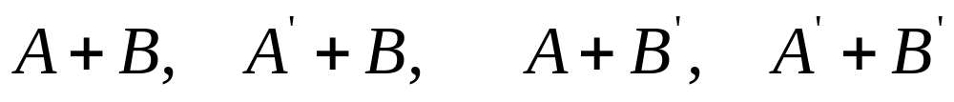
Maxterms
Consider variables A and B
Assume that they are somehow combined with OR operator
There are 4 possible combinations
Each of those terms is called a maxterm (standard sums)
In general, if there are n variables, there are maxterms

Slide 22








Exercise
List the maxterm for 3 variables
A | B | C | Maxterm | Designation
0 | 0 | 0 | A+B+C
0 | 0 | 1 | A+B+C'
0 | 1 | 0 | A+B'+C
0 | 1 | 1 | A+B'+C'
1 | 0 | 0 | A'+B+C
1 | 0 | 1 | A'+B+C'
1 | 1 | 0 | A'+B'+C
1 | 1 | 1 | A'+B'+C'

Slide 23
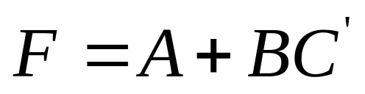
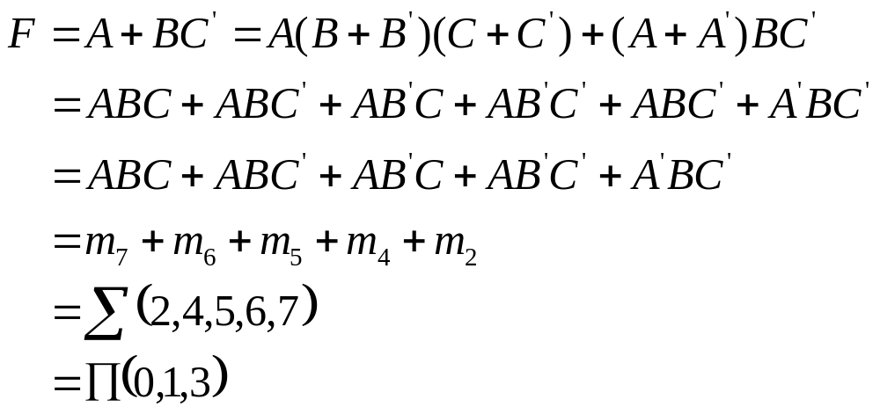
Example
Express F in the sum of minterms and product of maxterms formats

Slide 24
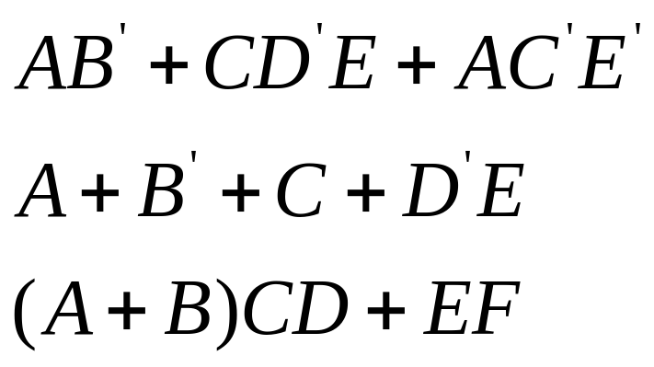
Sum-of-Products
All products are the product of single variable only
YES
YES
NO

Slide 25
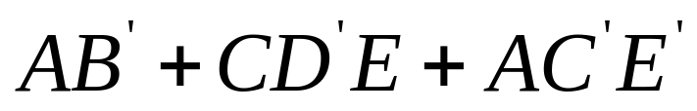







Sum-of-Products
One or more AND gates feeding a single OR gate at the output

Slide 26
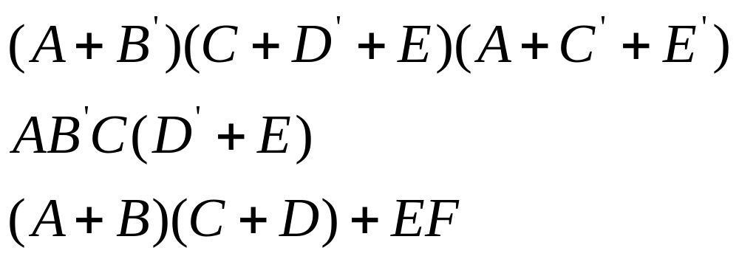
Product-of-Sums
All sums are the sums of single variables
YES
YES
NO

Slide 27
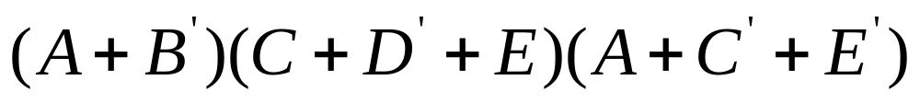
Product-of-Sums
One or more OR gates feeding a single AND gate at the output

Slide 28
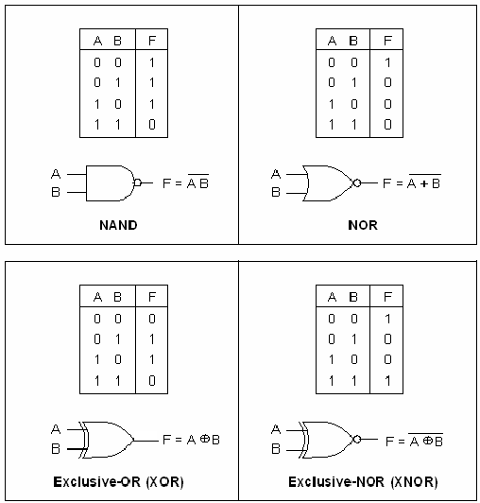


Logic Gates

Slide 29
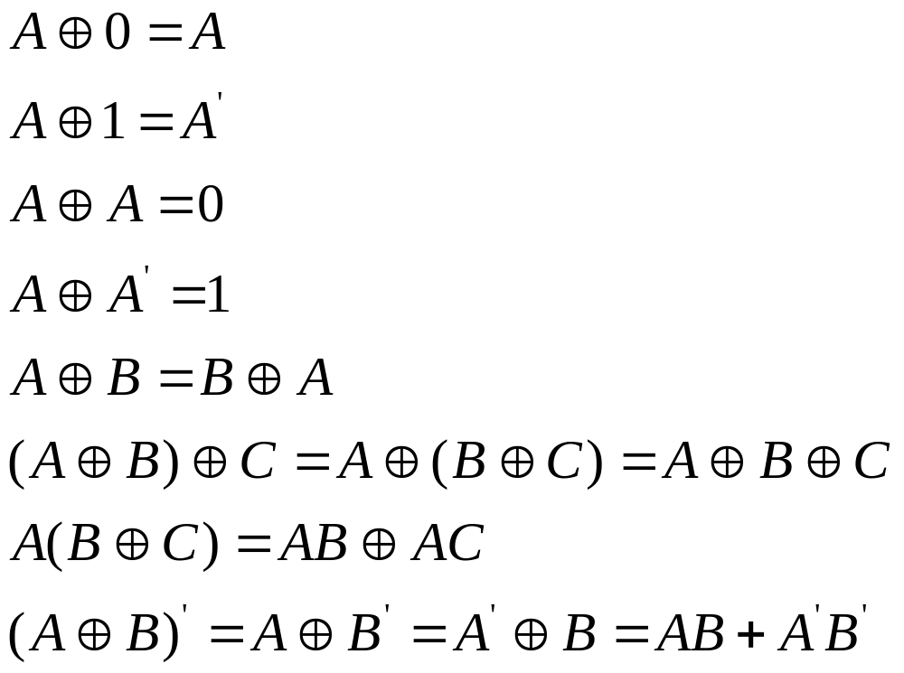
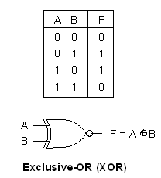
Exclusive-OR

Slide 30
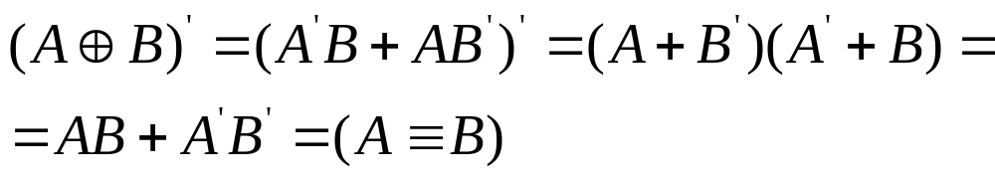

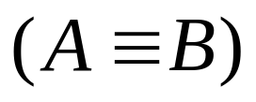
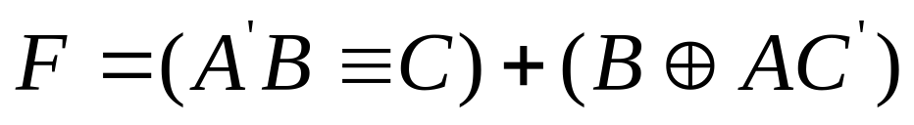
Equivalence
Equivalence is the complement of exclusive-OR
A
B
Simplify it…

Slide 31
Integrated Circuits
SSI (Small Scale)
  Less than 10 gates in a package
MSI (Medium Scale)
  10-1000 gates in a package
LSI (Large Scale)
  1000s of gates in a single package
VLSI (Very Large Scale)
  Hundred of thousands of gates in a single package

Slide 32
Study Problems
Course Book Chapter – 2 Problems
  2 – 1
  2 – 3
  2 – 5
  2 – 8
  2 – 12
  2 – 14

Slide 33

Questions

